Slide 1
.Net 6 – Text Analyze with Azure TextAnalytics
WorkSHOp
David Rodriguez

Slide 2
Agenda
Overview
Data Source
Creating a demo
This section covers the following:
What is Azure Text Analytics
What can I do with text analytics
How create analytics endpoint
Test in postman
This section covers the following:
Create account twitter dev
What information can be obtained through the Twitter API?
Test in postman
This section covers the following:
Create project in .NET 6
Project structure (minimal API) DI, Swagger…
Add libraries to own project
Test

Slide 3
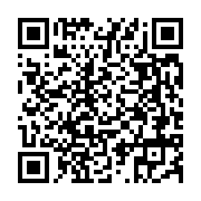
Don’t Forget
Content
Please scan the QR code and get the Resources of Workshop

Slide 4
Overview
Content
What is Azure Text Analytics:
“Text Analytic is an Azure Cognitive Service for Language is a cloud-based service that provides Natural Language Processing (NLP) features for understanding and analyzing text. Use this service to help build intelligent applications using the web-based Language Studio, REST APIs, and client libraries.” [1]
1: https://docs.microsoft.com/en-us/azure/cognitive-services/language-service/overview

Slide 5
Overview
Content
What can I do with text analytics :
With Text Analytics we can explore different analytics model’s theses models are:
Named Entity Recognition (NER) *
Personally Identifiable Information (PII) detection
Key phrase extraction *
Entity linking
Text Analytics for health
Analyze sentiment and opinions *
Language detection *
Custom text classification (preview need training model)
Text Summarization (preview) *
Conversational language understanding (preview need training model)
Question answering (need training model)

Slide 6
Overview
Content
How create analytics endpoint:
To create a text analysis service in azure, the following is necessary:
Azure account
Preferably this account has credits (advance functions or many operations peer second)
Steps to create
Go to the home page at https://portal.azure.com -> in the search bar type cognitive services and select the result with this name -> then go to the language section -> select the option create in the Language Service card, where you must follow the service configuration instructions.
In the next section you can select additional features such as questions and answers, personalized text classification and extraction, once selected we continue by clicking on continue to create your resource.
In the creation form follow the instructions, select the subscription, resource group (if you don't have one, create one), select the region (Not all regions have all services and the price changes for each one), enter the name of the service and select the rate plan, if the free plan is available (F0) select it (this applies only for the first service), if you have more than one, the standard plan applies, if you selected any of the additional features, you must select the region of the search service and select the free plan F, click on review and create and wait for the resource to be created.

Slide 7
Overview
Content
Test

Slide 8
Data Source
Content
Create account twitter dev:
Create a twitter account, next go to twitter developer site https://developer.twitter.com/ and register this site question what do you use propose our API´s
What information can be obtained through the Twitter API?
Tweets *
Users
Spaces
Lists
Media
Polls
Places

Slide 9
Data Source
Content – 10:15 – 10:30
Test - break

Slide 10
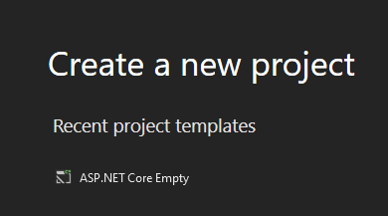
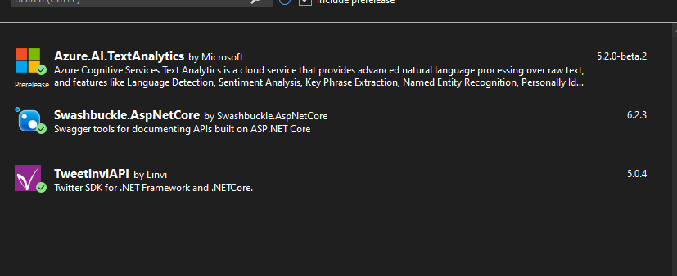
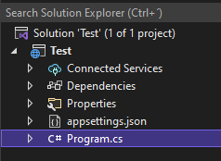
Creating a demo
Content
Create project in .NET 6
Project structure (minimal API) DI, Swagger…
Add libraries to own project
Test

Slide 11
Creating a demo
Content
Test

Slide 12
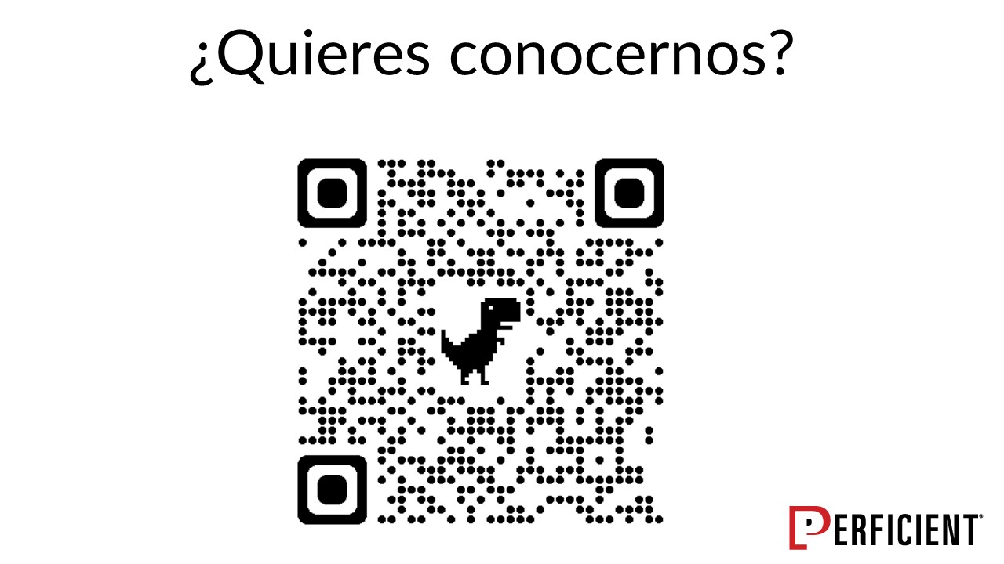
Don’t Forget
Content
Please give us your contact information

Slide 13
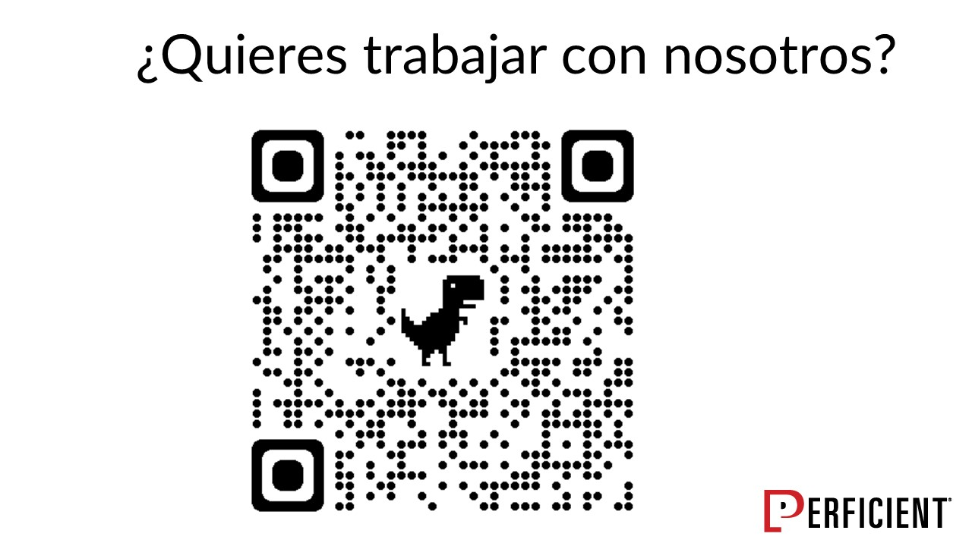
Don’t Forget
Content
Please give us your contact information

Slide 14
jdavidrparra@gmail.com
gelb0216 @gmail.com

